Slide 1
The voice of nursing
Oral history at the RCN
Notes:
Hi, my name is Fiona Bourne, I’m the archives manager at the Royal College of Nursing, which is a professional association and trade union for nurses. The archive is made up of corporate records, personal papers collections and significantly an oral history collection which I’m here to talk about.
My abstract, which BISA accepted was largely about digital records and so I warn you now, it isn’t all pretty pictures. However I have included as many as I can to break up the big white patches.

Slide 2
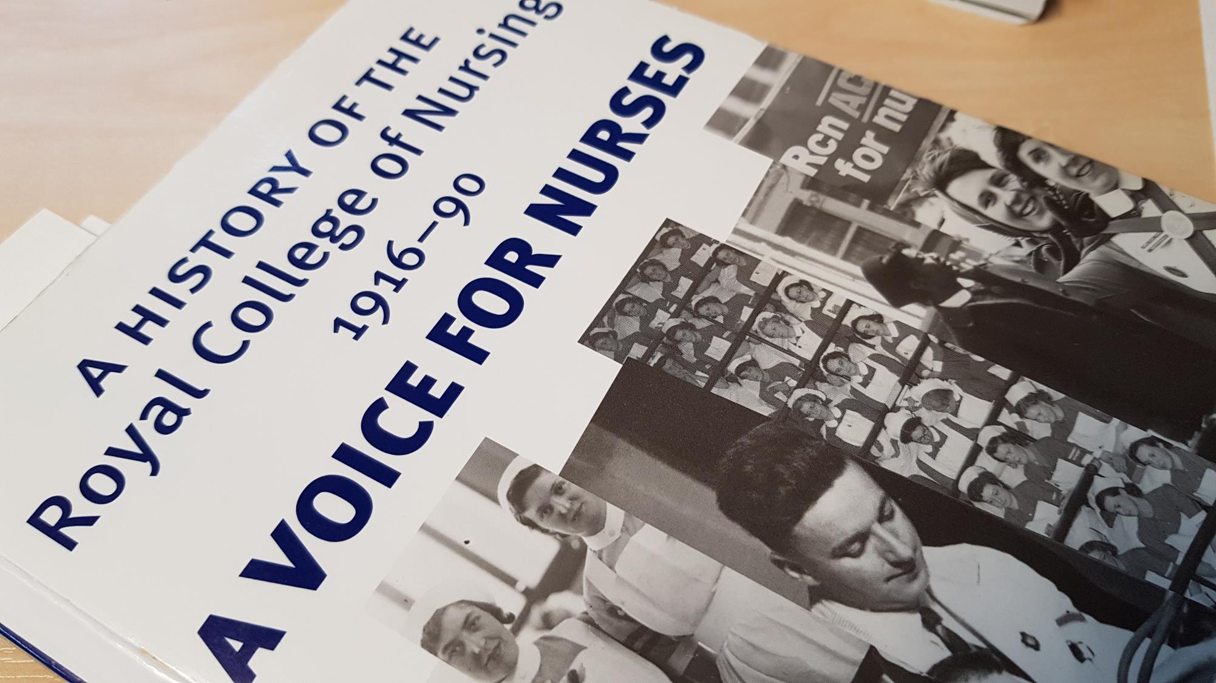
Notes:
Just to explain the title, the RCN is referred to in the nursing field as the voice of nursing because of it’s vast membership comprising over 60% of the NHS and private workforce currently providing nursing services to patients. The official history of the RCN is pictured here and makes a play on this reputation. I like to think it’s at least partly because of our oral history collection too. After all the spoken word is powerful. This is my rather well worn copy trying to look arty.

Slide 3
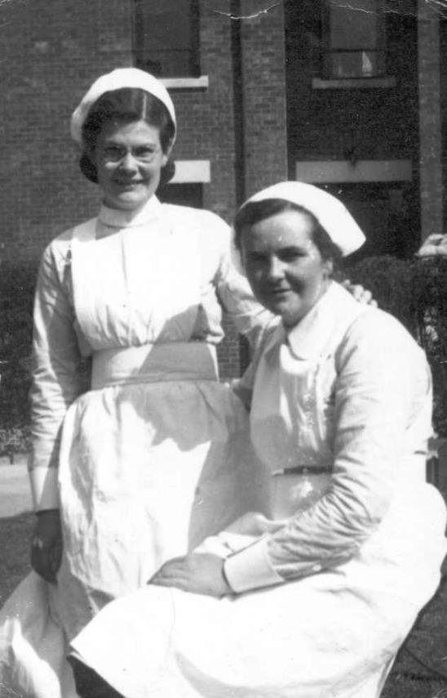
Collection Service Future
Notes:
I’m going to split my talk into these three areas today.
I’m going to talk about the collection, then try to explain what kind service we aim to provide for users. And finally take you through where we are now and where we think we’re going. I hope that will be good.

Slide 4
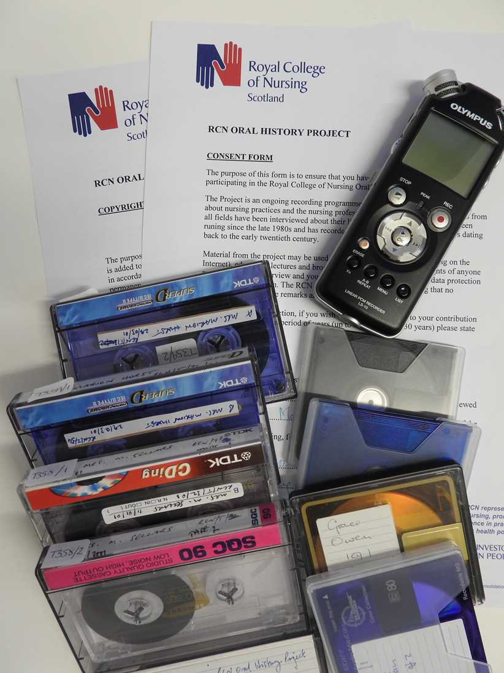
Oral History Collection

Slide 5
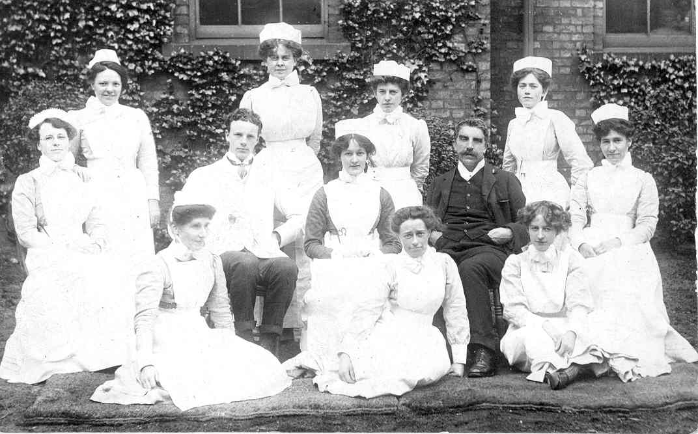
Collection Origins
RCN History of Nursing Society
Started in the 1980s
Passive programme
Research projects
Notes:
This is a collection of oral history interviews relating to nursing in the UK, c.1893-2018. The interviews are with nurses, health care practitioners, nursing leaders, both RCN members and staff and non-members from across the UK and some overseas nurses. All of the individuals interviewed are connected to nursing and share information about themselves, their education, careers and experiences in the profession. The interviews comment on important developments, changes and events that have affected the profession, both clinically and in a wider socio-economic and political context. They also share feelings about leaving home, working in difficult situations, loss, pride and the satisfaction a nursing career can bring.
The drivers for the creation of both the RCN archive and this oral history collection have been the nurses who are members of the RCN History of Nursing Society, a specialist interest group of our general membership. Members of the Society were concerned about access to the history of the RCN and in capturing a fast disappearing opportunity to record the experiences of retired nursing leaders. The early interviews were considered ground-breaking for women’s and social history, as they focused on an employment sector that has a strong gender bias.
The RCN archive was established in 1986 with the appointment of the first archivist. The recording of oral history interviews by members of the RCN History of Nursing Society working in academic research had already begun, but organising and collecting them quickly became the RCN archivist’s role. Recording is still led by nurses who use oral history as a research methodology in their work and the project has become an important community activity.
The archivist has professionally overseen RCN History of Nursing Society volunteers in creating this collection and has been also able to select the most appropriate external research projects for inclusion when they were offered. Consequently, the collection content is highly cohesive despite its size and has a standardised structure.

Slide 6
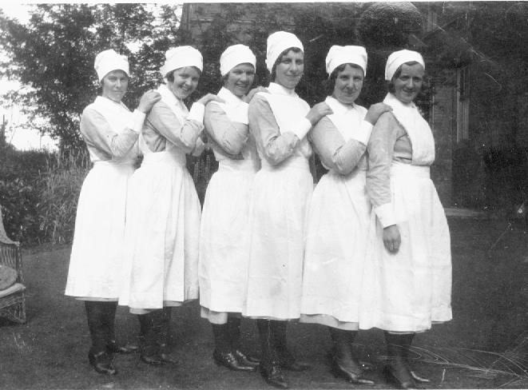
Managing and Growing the Collection
Technology
HLF Project
Regulation changes
Engagement
Targeted collecting
Volunteers
Notes:
The early interviews were recorded on cassette, some on minidisk and more recently digitally as mp3 or wav files.
The RCN Archives team converted the analogue items in the collection to digital formats (wav files, with mp3 copies) in a three year HLF funded project which also created verbatim transcriptions (Word documents) for the collection. Transcriptions are not visible online although they are harvested for catalogue search results.
The laws around personal information and copyright have also moved on. The idea of sharing information online like we do now was never dreamed of in the 80s. Consent and copyright forms and donation agreements accompany the collection complete with GDPR statements.
The RCN has changed too. It was engagement with members which introduced this activity to the archive and it has become an integral part of our work but is still led by our members. We have more staff now working here and in the archive and we can afford the time to target particular gaps in the collection and also topics which may be relevant for the team building our exhibitions.
The other great change for us is that we now have more volunteers who are enthusiastic about recording and helping build the collections. Without volunteers we simply wouldn’t have the resources to do this.

Slide 7
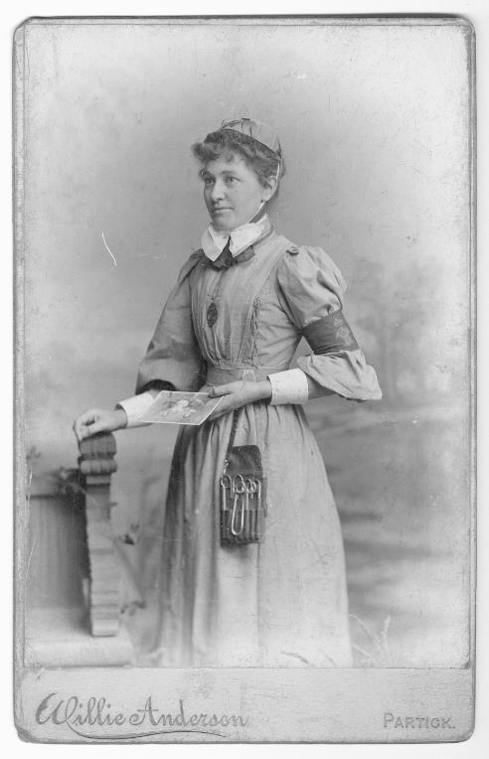
Statistics
472 interviews recorded by volunteers since 1986
700GB wav files digitised and stored 2008-2011
420GB mp3 and word files stored as
access copies on server
257 interviews donated as parts of research projects
And more are being created as I speak…
Notes:
We hold over 700 interviews and they are all digital. 472 of the interviews have been conducted by volunteers or RCN staff since 1986. The RCN also encourages the donation of completed nursing research projects from researchers who are not RCN members and those who are not nurses. At least eight original individual research projects consisting of 257 interviews have been included in the collection to date, with more being added each year.
Capacity is a big issue for us. Network capacity is limited as the RCN is a medium sized company with moderate needs – the whole network comes in under 9TB. Getting servers dedicated to concepts such as archival preservation is tricky to say the least.

Slide 8
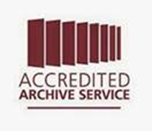

Service
Notes:
We put a lot of effort into delivering a high quality service when people come to use looking for information, which has been recognised through our archives accreditation and customer service excellence awards.

Slide 9
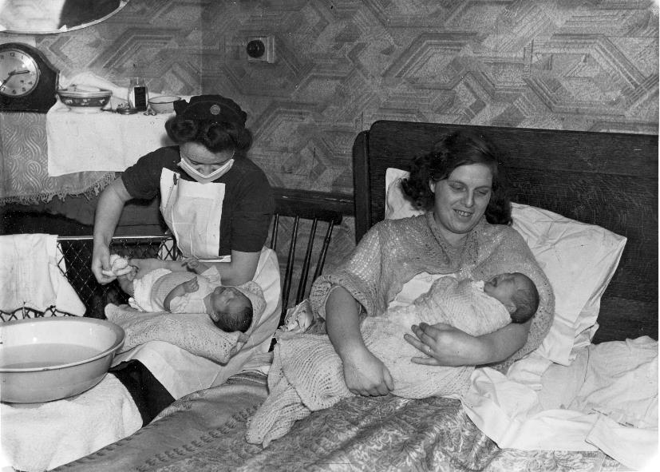
Priorities

Slide 10
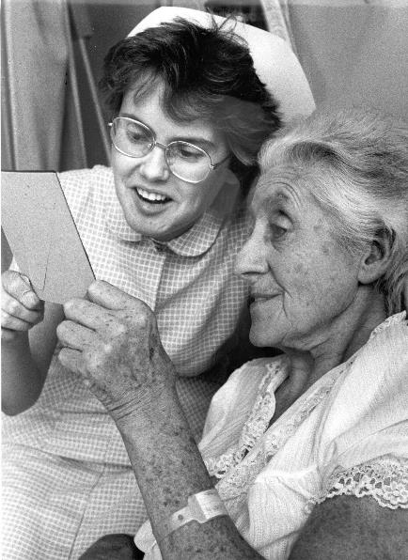
Access to Collections
Researchers
Exhibitions and events
Media
Formats
Technology
Notes:
One of the main purposes of an archive is to collect interesting stuff for people to use. We’ve established that this collection is pretty interesting stuff so how do we make it available and who to?
Researchers are our main audience, they can be anything from PhD students to family historians or anything in between.
Our exhibitions and events would be less than sparkling without a regular input from the oral history collection used in conjunction with our other collections and with member involvement.
The media tend to want soundbites, but also they want facts and short quotes. The collection lends itself to this well.
When people come in, having arranged a research visit they often have very little time. They may be funded to do 5 archive visits in one week for their projects and they need to get through material quickly. They just want to see transcriptions, they have no interest in the audio. Our exhibitions team on the other hand are after audio extracts for our kiosk in the gallery area.
Technology can be very enabling but for various reasons might not help you achieve the level of service you want to provide. For example the in-house RCN audience can be shown material in the archive which is not copyright cleared. If I set these records to ‘open’ so they can see our holdings, how do I re-use that same catalogue to go external to the internet? I’d love a big switch on the side of my PC which switches off everything copyrighted for me.

Slide 11




Trusted Rights Management
Notes:
This is another important reason we might restrict what goes online. We have to prioritise data protection and rights management in our work as a trusted and accredited archive. Aside from legislation we know that working ethically is working professionally. We ensure that the information remains in our control not by denying access but by managing it in respect of people’s wishes. That is part of the agreement for interviewees who all provide their consent and copyright assignment. So we don’t put everything online because we couldn’t control downloads and copying and subsequent use. We help people access it on site and provide guidance and context for their research.
I really laughed when I saw that picture and just had to include it because we’re always discussing discoverability of our resources and catalogues and how to improve it – Suaron’s tower in Mordor from Lord of the Rings in case you can’t recall. The fiery all seeing eye in this case of Google!

Slide 12
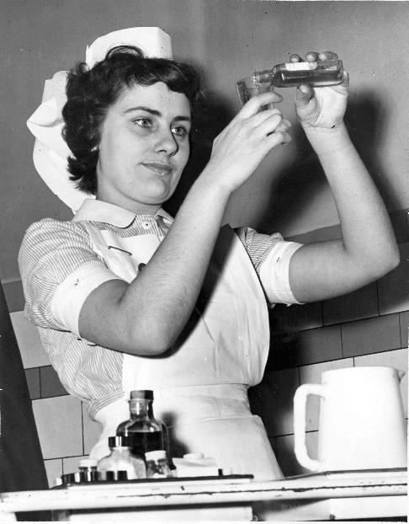
Preservation at the RCN
Project to address preservation
Moving collections
Preservica
Location of files
Access
Online?
Notes:
Preservation is the other of the two main purposes of an archive. We are duty bound to ensure that the material we have which is currently accessible stays that way, or at least in some format. We use generic widely used and stable file formats for our recordings.
We got a brand new shiny digital repository in 2017 as part of a pilot project to address digital preservation for the RCN.
We are currently still testing out with new collection types each year. 2019 will be the year for the Oral History Collection’s major move. Each collection will be synchronised with the collection catalogue in CALM once it’s moved so we need to be methodical about this and do one at a time.
The repository is provided by Preservica. Its is external cloud storage, with an encrypted for security. It can find and migrate certain files types and create copies in new formats, very exciting. Our contracted capacity will need to be increased to accommodate the work of ingesting the Oral History Collection.
For now, we intend for our wav recordings to exist here in the digital repository which has restricted access. And for our mp3 copies and word documents to go on the server housing our catalogue software.
Library and Archive Service staff will be able to search the collection behind the scenes and enable researchers and visitors to access the recordings or transcriptions on site at our offices in Edinburgh and London.
Ultimately we would prefer the collection to have a great catalogue and to have this online so people can find things for themselves, but currently we are unable to get the staff resource to get this going.

Slide 13
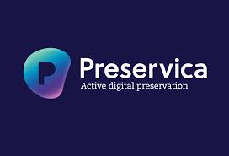
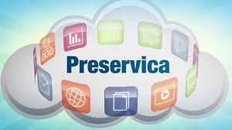
Future
Notes:
And now where we’re at or trying to get to
I found these two images on their website and I don’t know about you but I prefer the happy cloud with an information roundabout thing going on.

Slide 14
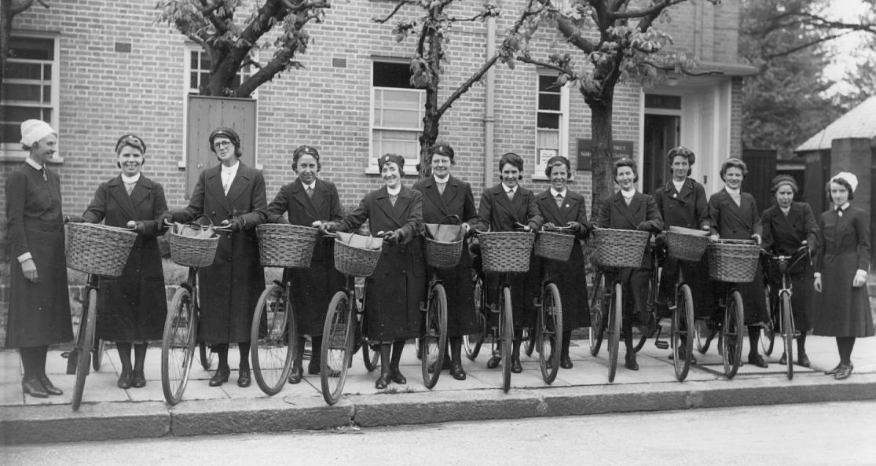
Technical Bit Warning
Notes:
I did promise…

Slide 15
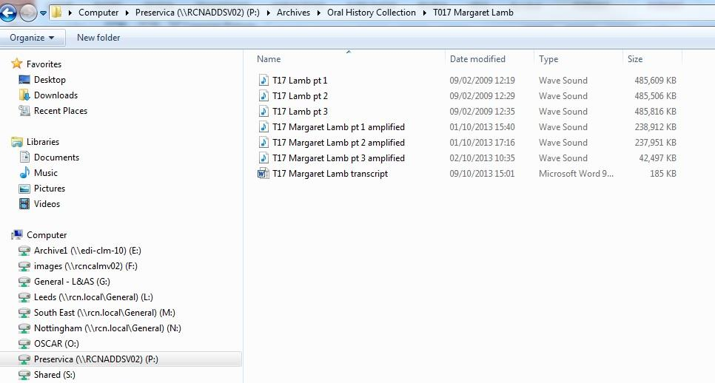
How do we do it?
Notes:
Step one is to get your files where you need them. This is the folder we use for accessioning, appraisal, selection and sorting prior to upload to Preservica. It takes a while to get records ready.
Note that the selected interview is in three parts, all of which needed amplification to be useful. These are the wavs and there is a transcript there.

Slide 16
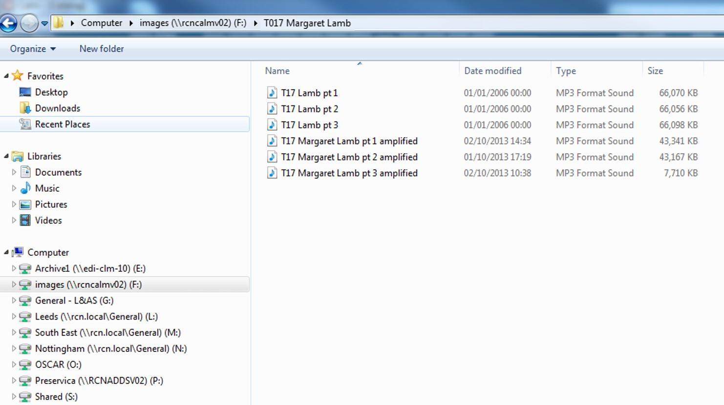
Notes:
Step 2
This is the folder used by our catalogue software. If I want to attach an image or recording to a record so it can be displayed I have to add it to this server. Note that these are the mp3 copies. They are smaller but still pretty big.
Our catalogue software is CALM version 11 which works with a web browser called Axiell Collections which we are currently setting up to use in-house across the RCN sites.

Slide 17
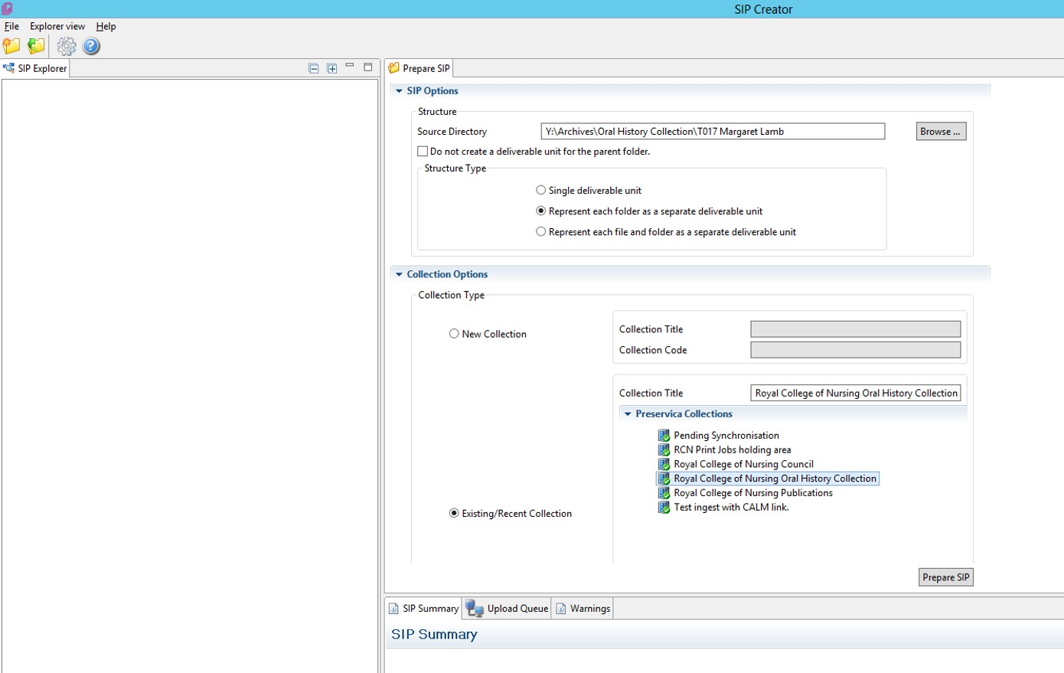
Notes:
Step 3
Open the SIP creator. This is part of Preservica which they are about to update. It stands for Standard Ingest Package, catchy! We have selected the location of the wav and word files to be picked up – that’s where we saw them before. And we select ‘represent each folder as a separate deliverable unit’, which is how the catalogue shows it and so will be able to link to those records later on.

Slide 18
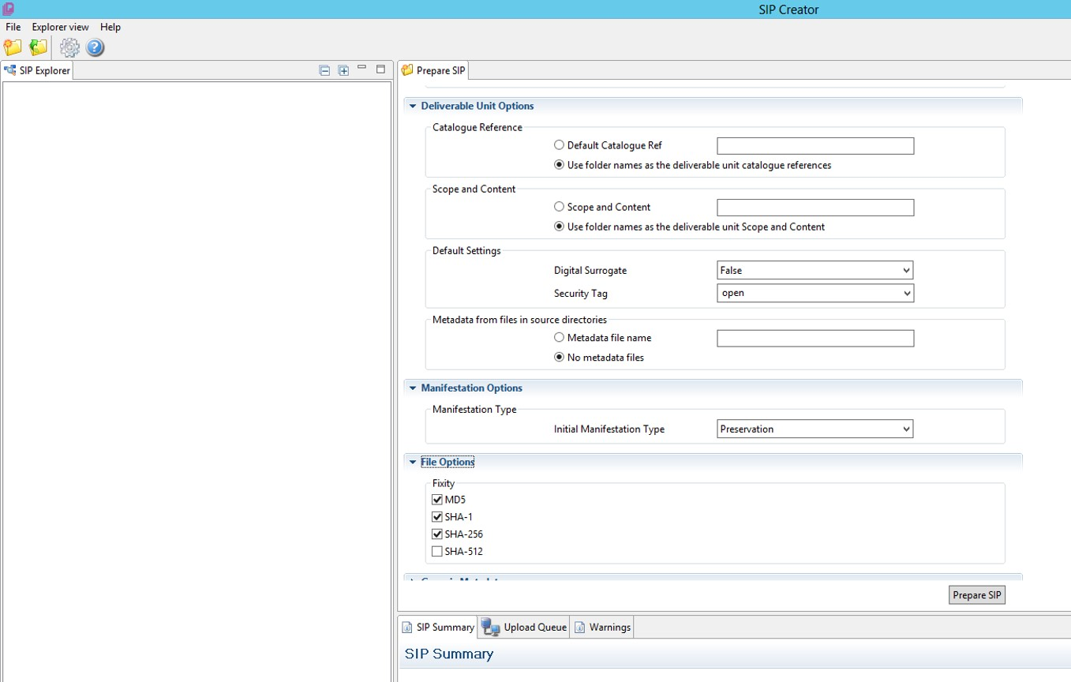
Notes:
Step 4
These are more options so we keep the folder names and to show that this is the original digital record. The manifestation is set to preservation, which is why we are keeping this – it’s not a presentation copy or anything. And the file options include which algorithms to run to create the checksums for the file.

Slide 19
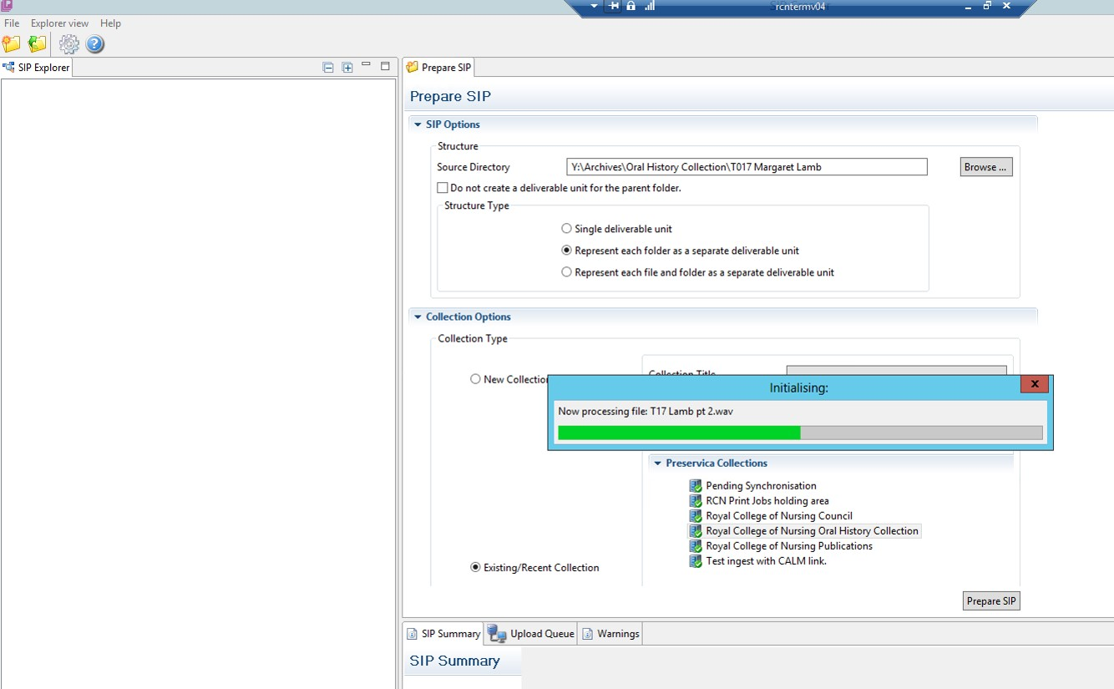
Notes:
Step 5
This is simply the SIP being created

Slide 20
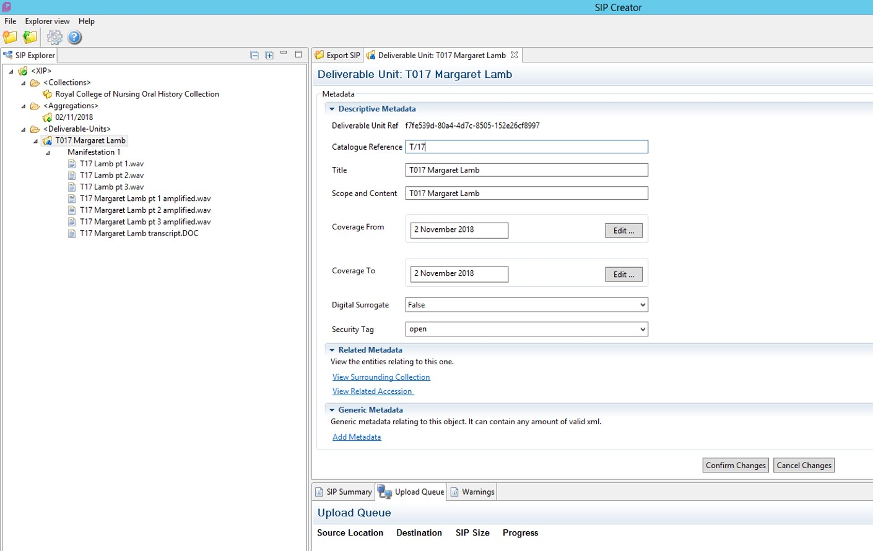
Notes:
Step 6
Now the records appear on the left and we have an option to edit the metadata here before we upload it.

Slide 21
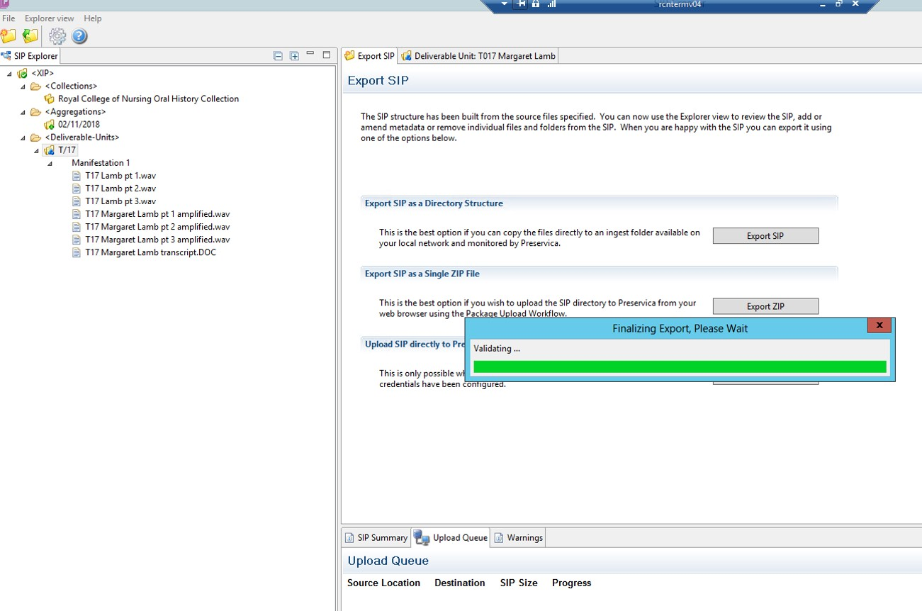
Notes:
Step 7
And there it’s being made ready to join the upload queue.

Slide 22
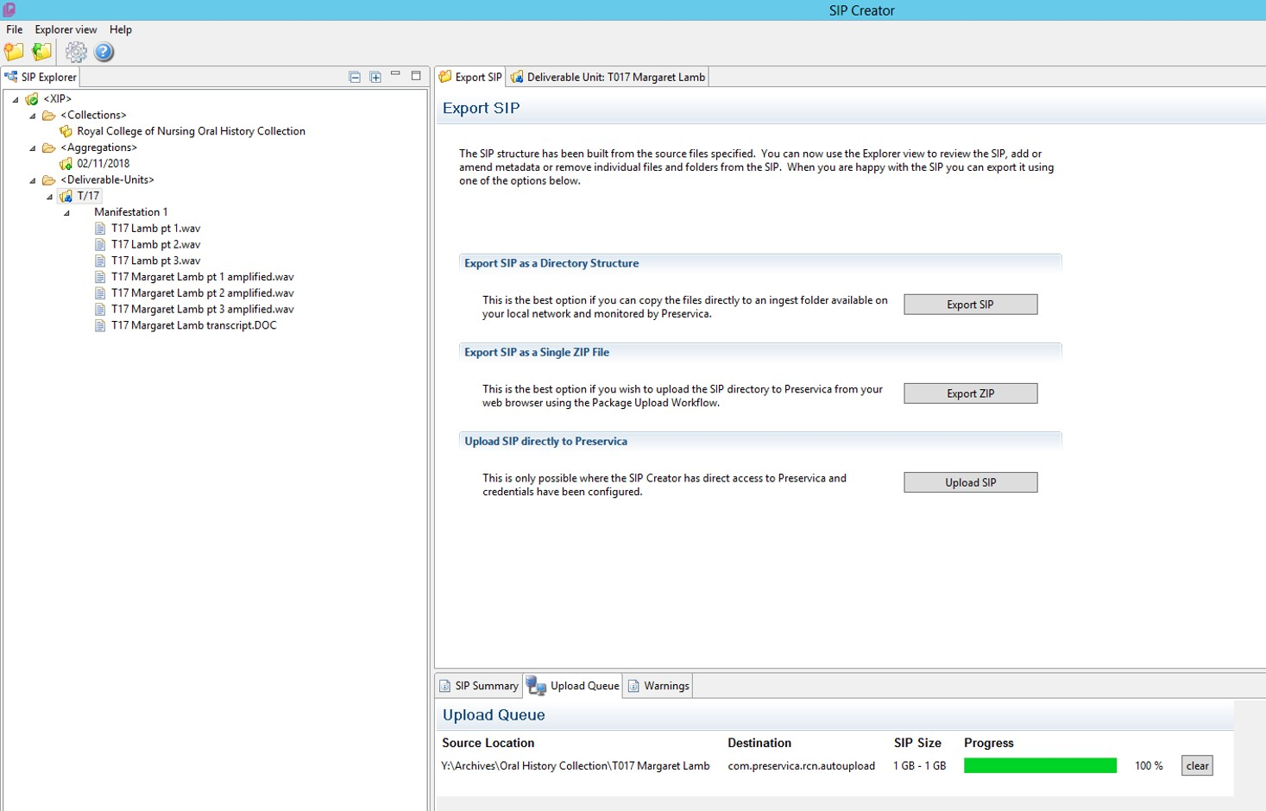
Notes:
Step 8
SIP ready for the upload.
So we’ve told Preservica where to get the file and what to do with it, including what we want to use the file for
And we’ve checked the catalogue and added the right information from it.

Slide 23
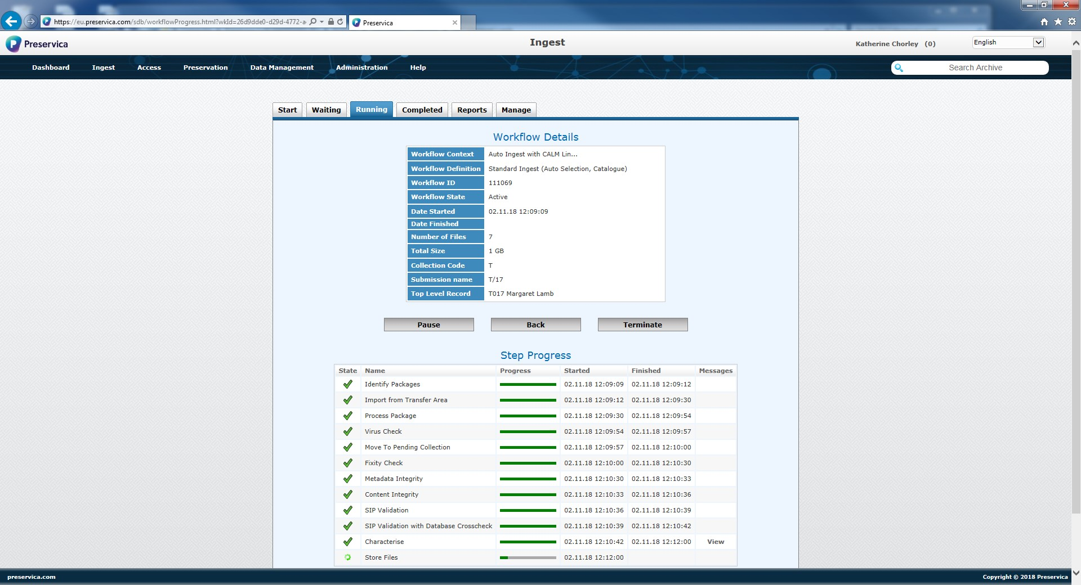
Notes:
Step 9
We go to the Preservica dashboard online where we control the workflows for managing the digital repository. This is the ingest workflow. You might be able to see the software running through identification, virus checking, validation, characterization and the creation of technical metadata which are all standard steps for uploading records.

Slide 24
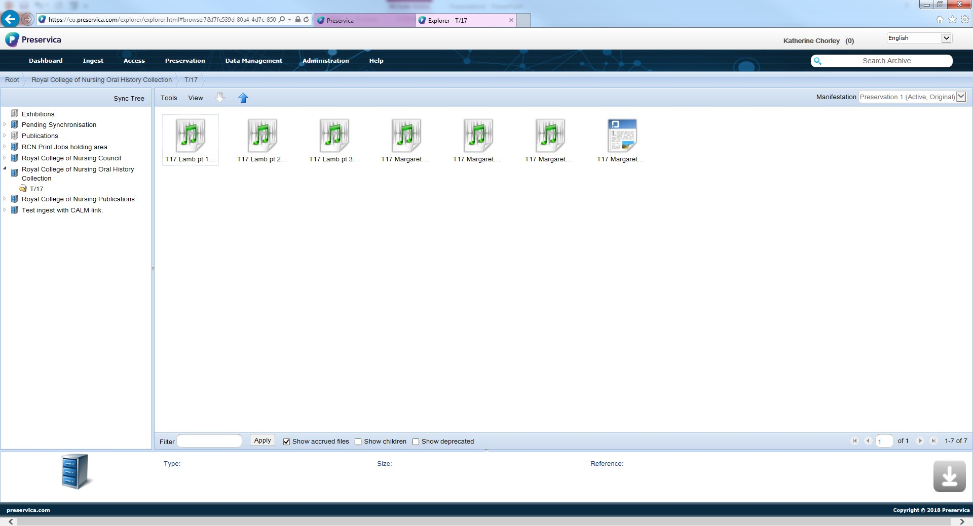
Notes:
Step 10
In the explorer view of the dashboard now. These are how the files appear from that folder – you can see they are all together still and have the right names.

Slide 25
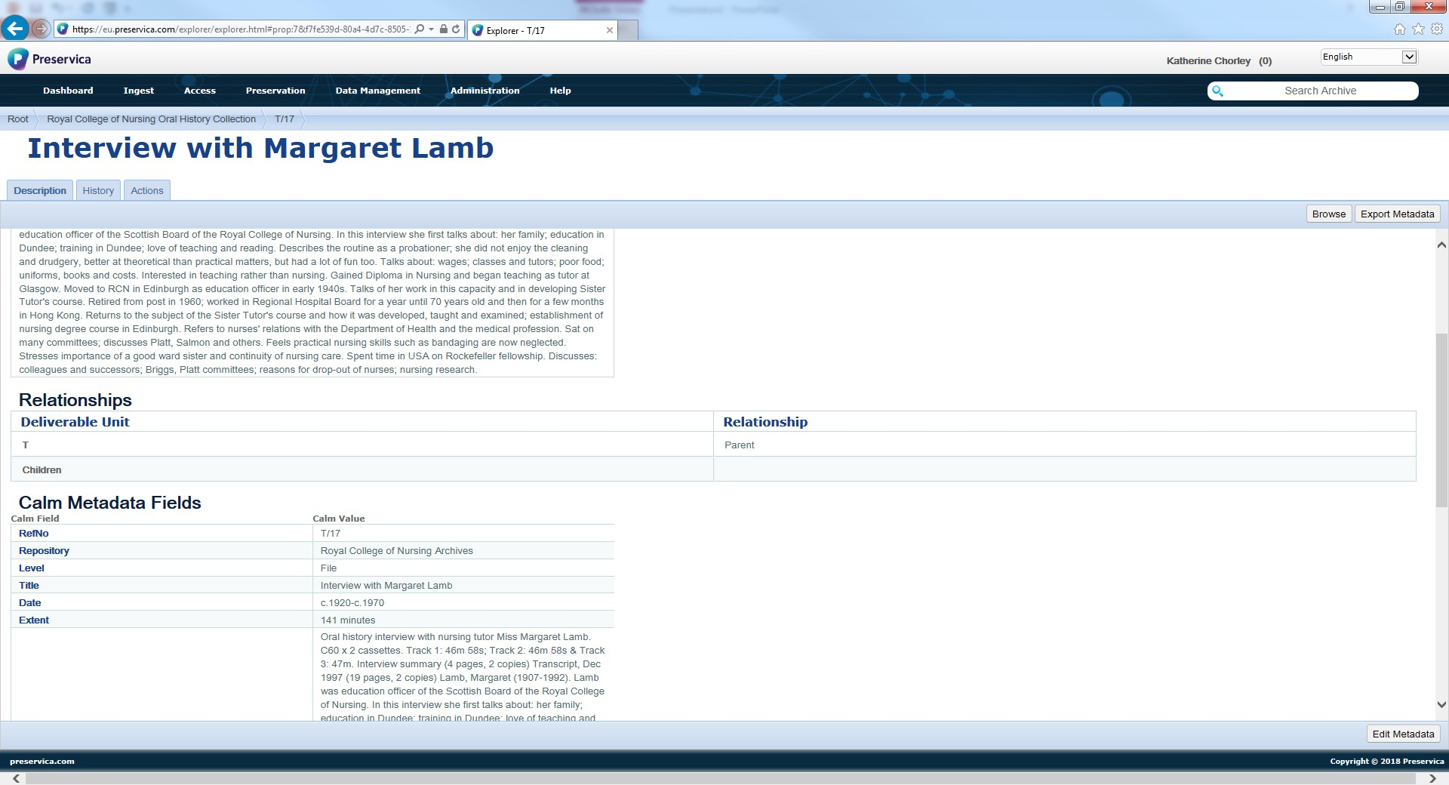
Notes:
Step 11
This is the metadata page for one of the records – it maintains a link with our catalogue through a permanent API so the software knows what record this is even before we link them. We spent a lot of time mapping our metadata schema to make sure this works.

Slide 26
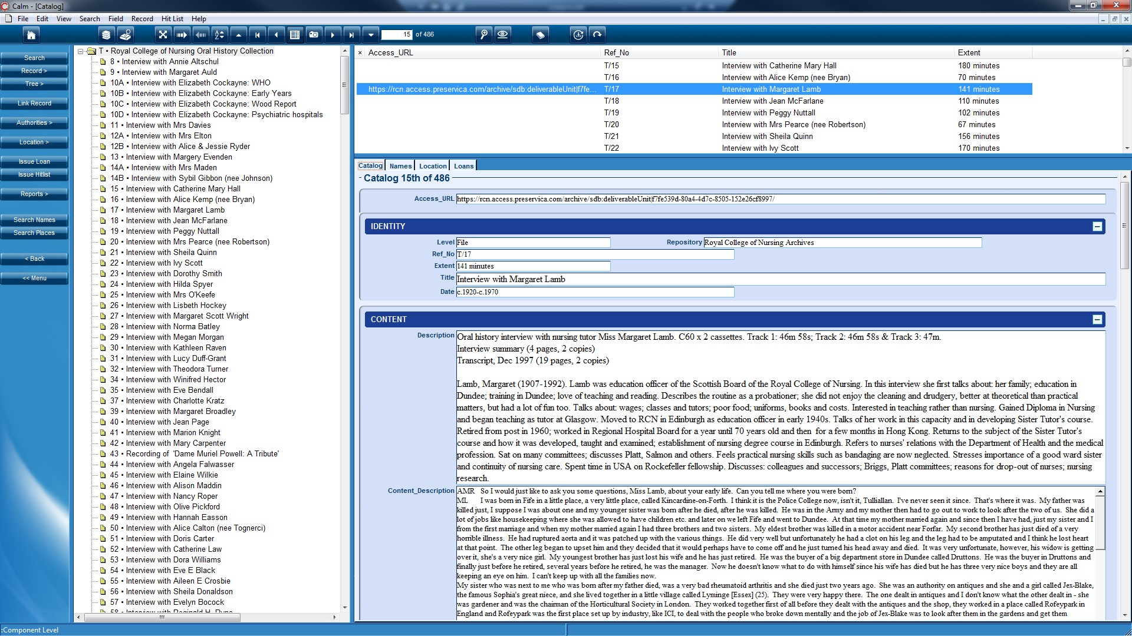
Notes:
Step 12
This is the CALM catalogue, you can see the information is already there – that’s where Preservica got it. The records are synchronised to produce that URL you see at the top of the CALM record.

Slide 27
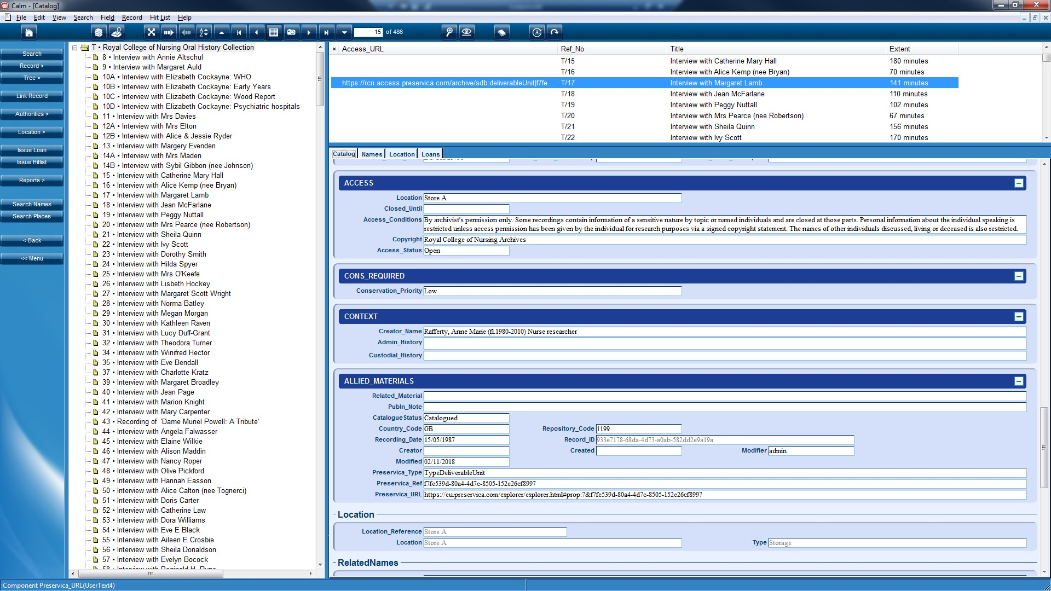
Notes:
Step 13
And also three other standard Preservica fields. This makes sure it is a one to one link. The URL can then be used to go direct to the record in the digital repository.
So it’s now preserved in its uncompressed format and accessible through the catalogue in house.

Slide 28
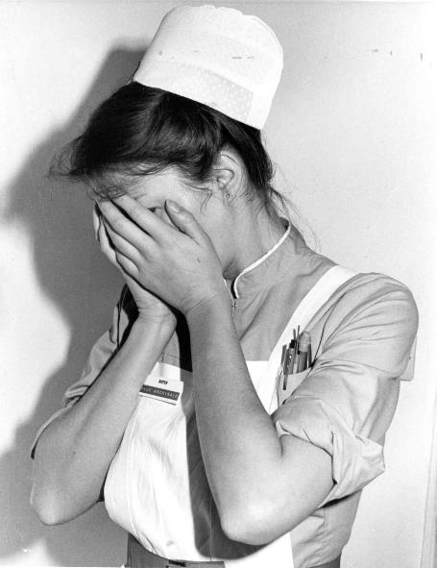
End of Technical Bit
Notes:
Whew, thank you
By the way this nurse isn’t really upset, she is taking part in a photo shoot for an article for the Nursing Standard about bullying in the workplace. I think she’s demonstrating how she’d feel about being shouted at. I definitely didn’t practice my presentation on her, honestly.

Slide 29
Digital Lessons Learnt
Not a problem
Bit of a challenge
File corruption
File types
Cataloguing style & metadata mapping
Limiting access to DR
Communication with IT team and acceptance of timescales
Sound quality
File size, server space and preparation for ingest
Notes:
So what did we learn from this? I have summarised here but please do ask for more information at the end.
We’ve got good files. They may be 10 year old files but they are not corrupted and there are backups and disaster copies at different locations.
We checked the range of file types and found it compatible with Preservica – and by that I mean that active migration of files is possible to ensure digital preservation. All formats come from PRONOM, a list of software types that the National Archives maintains, and which Preservica incorporate into their software.
The most interesting bits were the discussions around how the records appear in the catalogue. We had very little problem with the metadata mapping stage as we use a very simple ISAD compliant template in CALM, limited non-mandatory fields and no user defined fields. Our biggest issue was finding the shared language to discuss the process. Our oral history collection is listed online but it isn’t easy to find what you want and we hope to start extensive work on improving it.
With limited access to the digital repository there is also no possibility of drive by digital donations.
The areas of challenge included communication and agreeing planning and timescales with a department under pressure whose main priority in maintaining member services not heritage.
We are under a lot of pressure to get these files off the network, but I’ve resisted rushing this because I can demonstrate that the digital repository is not just storage space. Although ultimately the physical storeroom and digital repository will do the same job for different record formats, procedures stop you from adding lots of uncatalogued material. The digital repository will stop functioning because of the API exchange of data will try to synch with the catalogue and fail. People pushing us off servers will need to pay for more staff for my department to enable me to comply with their wishes, which they won’t.
We often found that the original recording which had been digitised under a collaboration with a charity rather than by professional sound engineers was pretty bad. Despite clear warning in our training sessions one of our volunteers had recorded an interview on an old cassette on which you could still hear a full military pipe band playing Amazing Grace in the background. But needs must at this point. The practicalities are that visiting researchers mainly use the transcriptions and our in-house exhibitions team do what they can with the recordings when they want to use them.
Size, space and preparation are tied together. We discovered that the best way to work was using a virtual desktop where the SIP creator is located on the network server. That way we weren’t constrained to the limits of the PC we were working from. AV files took a crushingly long time to load because of size and available bandwidth but working this way made it possible at all. We also realised that it is far better to prepare your records fully and ingest them as they will appear in the catalogue rather than try to do more in Preservica. Preservica is a preservation tool, not archive catalogue or management software. So we decided to start using a ‘digital sorting room’ for all of our records.
We’ve yet to move the whole collection. The mp3 copies of the collection alone took 46 hours to move to the server where they link to the catalogue. That is still an issue which we may resolve with future versions of Preservica as I would rather have both copies in the digital repository and directly link to the access copy rather than it being on our network.

Slide 30
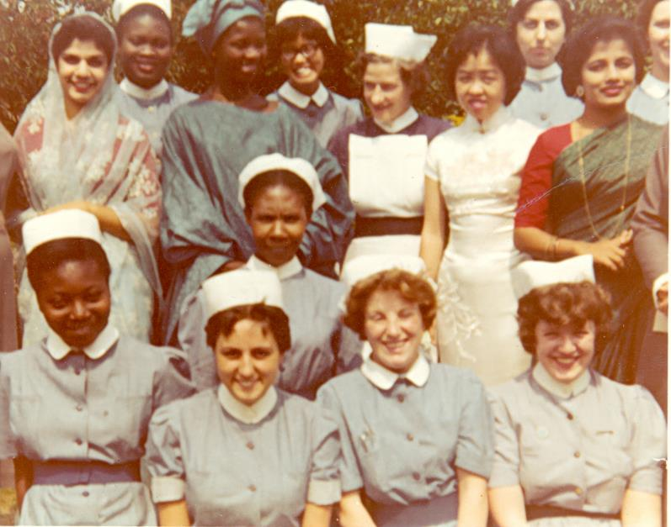
The (Digital) Voice of Nursing
Notes:
So hopefully we have secured the future of this digital collection and given ourselves some options on how to continue to use it. We also want to get moving on that cataloguing work to improve access. Our community is the nursing profession and our audiences extend UK wide and internationally. The collection motivates and engages our members, developing a strong relationship with our founding community which staff are deeply committed to and proud of. I believe we can maintain our reputation as the (digital) voice of nursing.

Slide 31
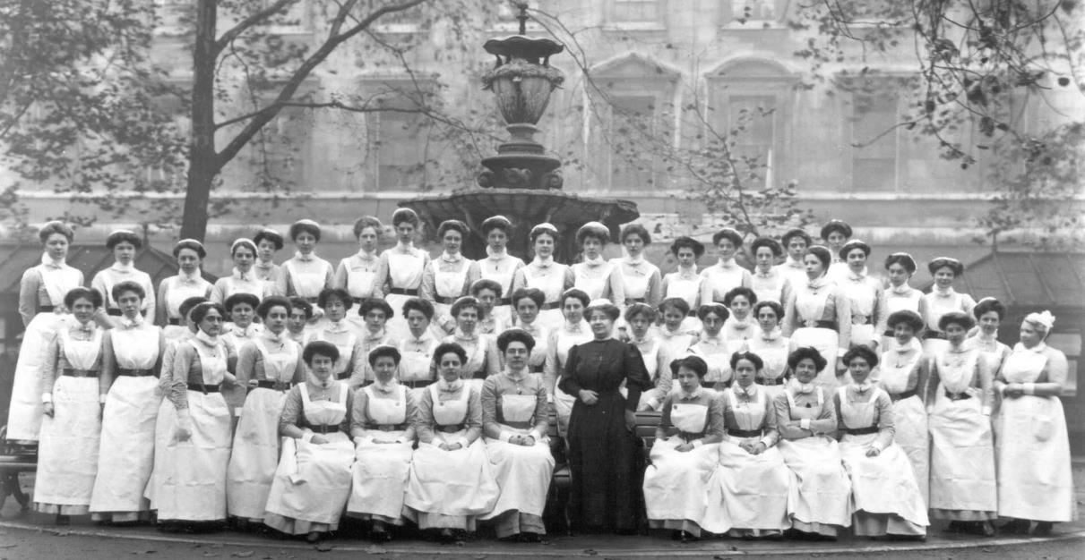
Thank you
rcn.library@rcn.org.uk #histnursing

